Slide 1
BIG DATA ANALYTICS WITH IBM CLOUD DATABASES
COLLEGE: UNITED INSTITUTE OF TECHNOLOGY COLLEGE CODE :7145
BATCHMATES: GOKULNATH S
LAKSHANA.A
MASANAM M
VISHAL R
VIGNESH S
RATHISH Y
GUIDE:Mrs.NISHANTHI
DOMAIN:CLOUD COMPUTING

Slide 2
Problem Description
Dive into the world of big data analysis with IBM cloud database.uncover insights from vast datasets,from climate trends to social patterns.visualize your findings and derive valuable business intelligence.Embark on data –driven adventures,exploring the endless possibilities of big data.

Slide 3
Big data and analytics overview:
The amount of data being generated inside and outside each enterprise The increasing volume and detail of information, the rise of multimedia and social media, and the Internet of Things are expected to fuel continued exponential data growth for the foreseeable future.
Two common sources of big data exist.
First, there is organizational data, which, thanks to improved automation and broader access, is increasingly being shared. Organizational data includes emails, system logs, internal documents, business process events, and other structured, unstructured, and semi-structured data. It also includes social content, such as any blogs and wikis that are available within the organization.
Second, data comes from sources outside of the organization. Some of this extra-organizational data is available publicly and at no charge, some of it is obtained through paid subscription, and the rest is selectively made available by specific business partners or customers. This includes information from social media sites and various other sources, including product literature; corporate information; health, life, and consumer websites; helpful hints from third parties, and customer complaints, such as complaints posted on the websites of regulatory agencies.

Slide 4
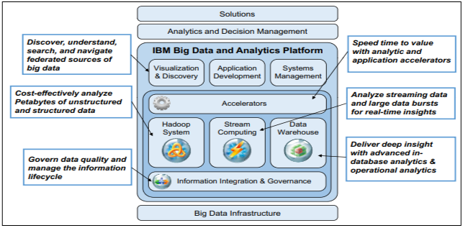
IBM Cloud Computing Reference Architecture
The IBM Cloud Computing Reference Architecture (CCRA) is a blueprint or guide for architecting cloud computing implementations. It is based on years of experience of IBM personnel working with customers on cloud computing solutions, and is driven by a broad set of functional and nonfunctional requirements collected during those engagements. The IBM CCRA (see Figure 1-4) provides guidelines and technical work products, such as service and deployment models, and defines numerous overarching adoption patterns. An adoption pattern embodies the architecture patterns that represent the ways that organizations typically implement cloud computing solutions.

Slide 5
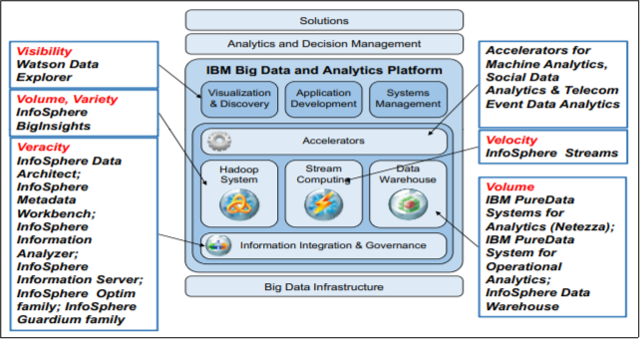
Big data and analytics exploration
In the big data and analytics exploration scenario, users want to discover more information about specific topics, using as much relevant information as possible. The following steps in this scenario are important:
Exploring new data sources
Mining existing data for relevant associations
Creating new business value from unstructured content
Understanding large data patterns with visualization and algorithms

Slide 6
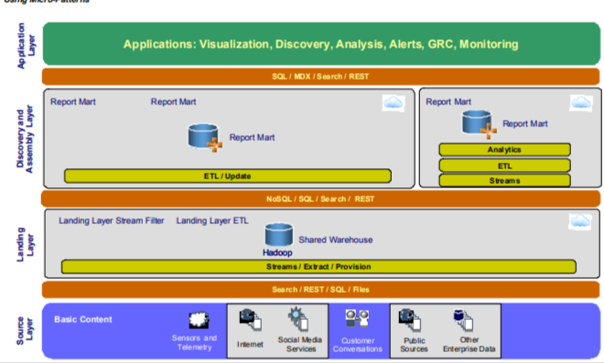
Exploration of Big Data
Source Layer data follows the usual big data ingestion pattern.
Real-time sensor and data acquisition is added to facilitate more timely analytics and decision making.
A virtual Search Mart offers dimensionally aligned search results using facets or similar taxonomy-aware grouping mechanisms.
This type of organization allows applications to show new information across familiar reporting dimensions without modeling. Analytics Marts are created from Discovery Tables. Statistical functions are applied to create data correlations that are exported to a report mart for use by higher-level applications.

Slide 7
Big data and analytics service ecosystem on cloud
A service provider can offer big data and analytics capabilities as a service ecosystem on a cloud, with organizations selecting their desired capabilities from a service catalog.
This big data and analytics capability service adoption model is suitable for most organizations, whether they are new to big data or have been working with it for years.
The model can be applied whether an organization needs only a few big data capabilities or many big data capabilities, whether or not it has in-house expertise, and even whether it wants to outsource the big data and analytics capability implementation.
The following list shows the most common big data capabilities that can be provided as services in a cloud model:
Extract, transform, and load (ETL) as a service
Visualization and search as a service Analytics as a service
Hadoop NoSQL as a service (analytics infrastructure)
Data warehousing as a service Reporting as a service
Entity analytics as a service
Policy and data governance as a service Database as a service

Slide 8
IBM SoftLayer for big data and analytics
With its SoftLayer cloud, IBM provides unique capabilities that enable companies to quickly deploy a public big data and analytics solution. The following key aspects of SoftLayer clouds differentiate them from other public cloud offerings:
Large, fast networks Companies offering cloud capabilities need significant bandwidth. A couple of servers in a single data center are not sufficient. The SoftLayer network and capacity are considerable. Thirteen separate data centers house about 200,000 servers at locations around the world (including the United States, Singapore, the United Kingdom, and the Netherlands), each connected to the others with dedicated 20 Gbps private network fiber links. SoftLayer has a triple network architecture (Public, Management, and Private).
Virtual servers for convenience, bare metal for performance A virtual server is a virtual machine running on a hypervisor (an operating system) and hosted on a physical server. The same physical server can host multiple virtual servers. So, one server running a Linux operating system can host additional virtual servers running Microsoft Windows or Linux. SoftLayer offers virtual servers that can be set up in minutes and scaled as needed.

Slide 9
In this kind of service hosting model, the service provider provides the service so that the subscribing organizations can focus on their overall business and IT goals, for example:
When the government intelligence agencies have an ad hoc need to perform social media analytics to assess and identify threats during national political events, they can subscribe to analytics as a service.
Financial organizations that need to generate quarterly and yearly reports can subscribe to reporting as a service to accomplish those goals without having to invest in technologies that will only be used occasionally.
Cyber security and crime-fighting agencies that must collaborate in their work can avoid the need for multiple software and hardware infrastructures by subscribing to information sharing as a service, where they can each have a common portfolio of services and systems to provide consistent results.
Several other SoftLayer features specifically support Hadoop:
– Deeply integrated and tuned analytics stack with best-of-breed cluster management
– Hadoop rack-awareness
– Exchange compression and anti-colocation of reduce allotments
– Increased Data Input phase redundancy
– HDFS buffer size tuning
-– Modifiable exchange sort implementation

